Slide 1
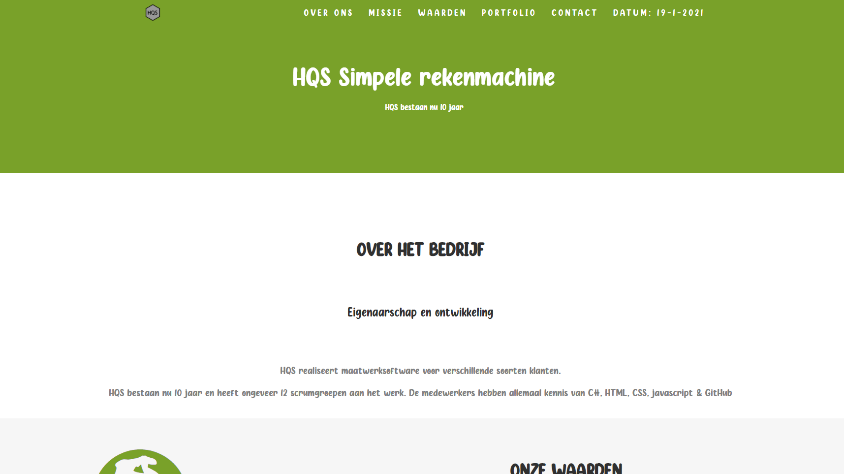
Project HQS
Door: Brian Klatt, Youri Blanckenborg, Stan van der Meijden, Luuk Bekhuis

Slide 2

Inhoud pagina
Website
Website code
Puppylove
Puppylove code
Simple calculator
Simple calculator code
DevOps
Github
Vragen

Slide 3
Website

Slide 4
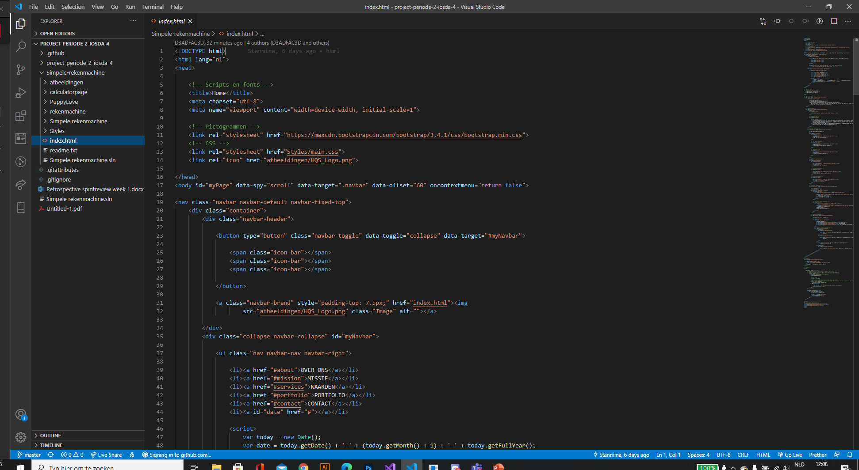
Website code

Slide 5
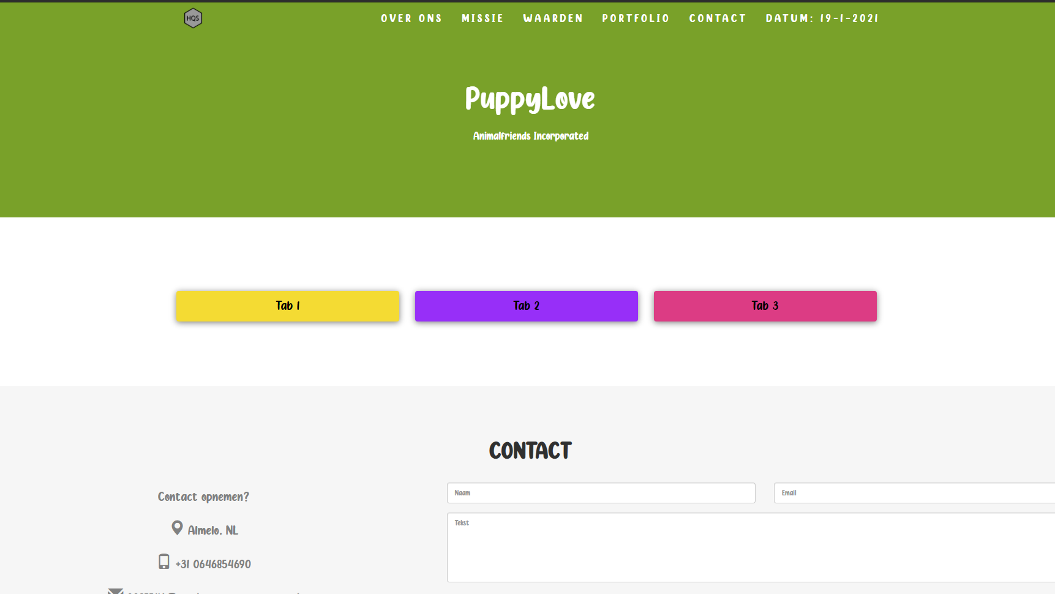
Puppylove

Slide 6
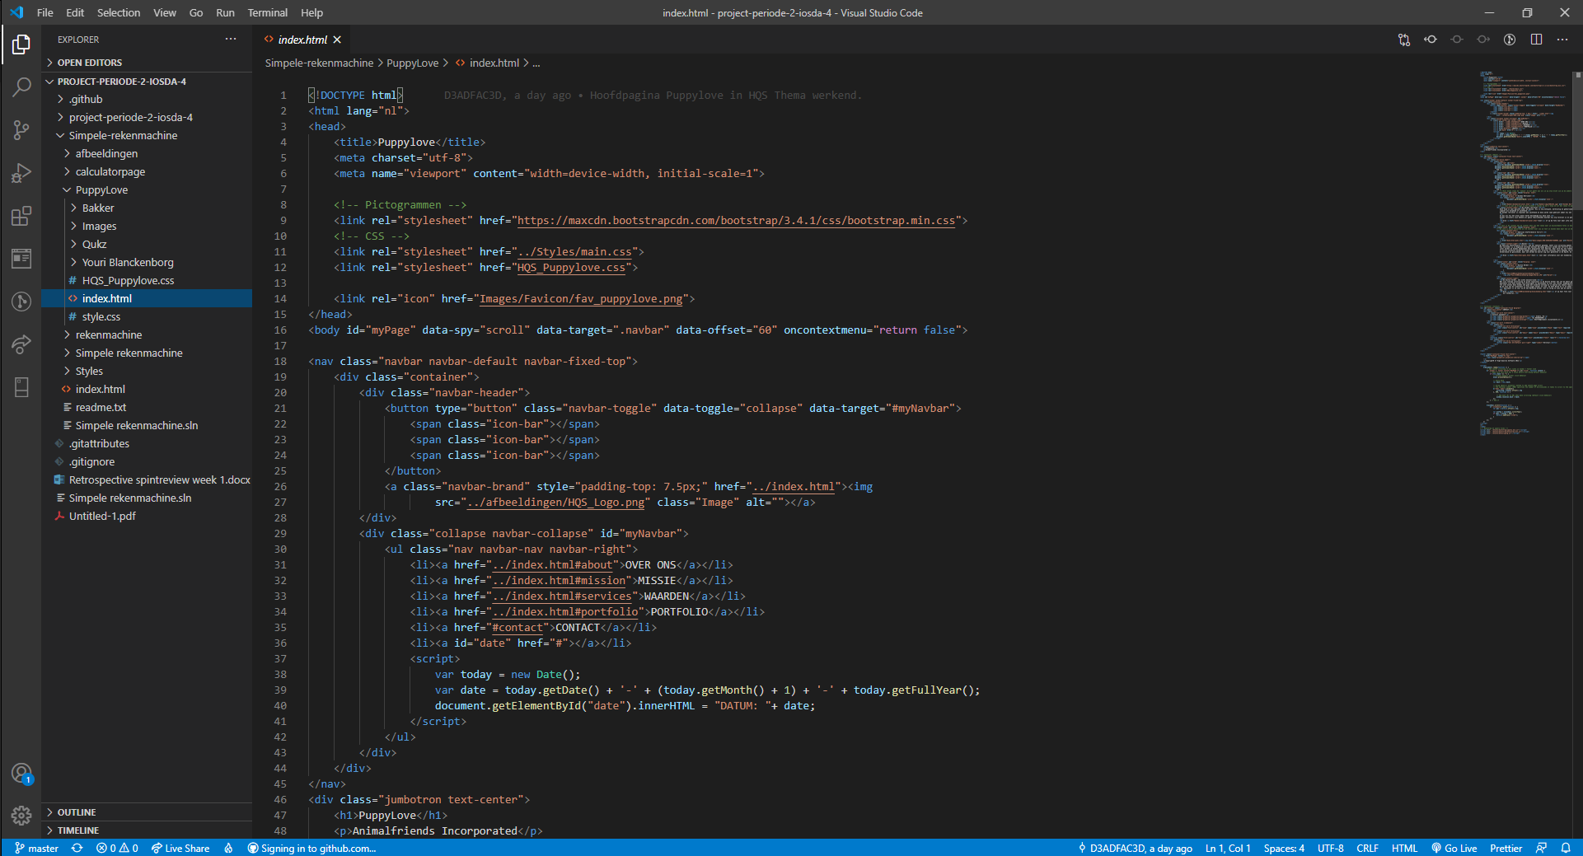
Puppylove Code

Slide 7
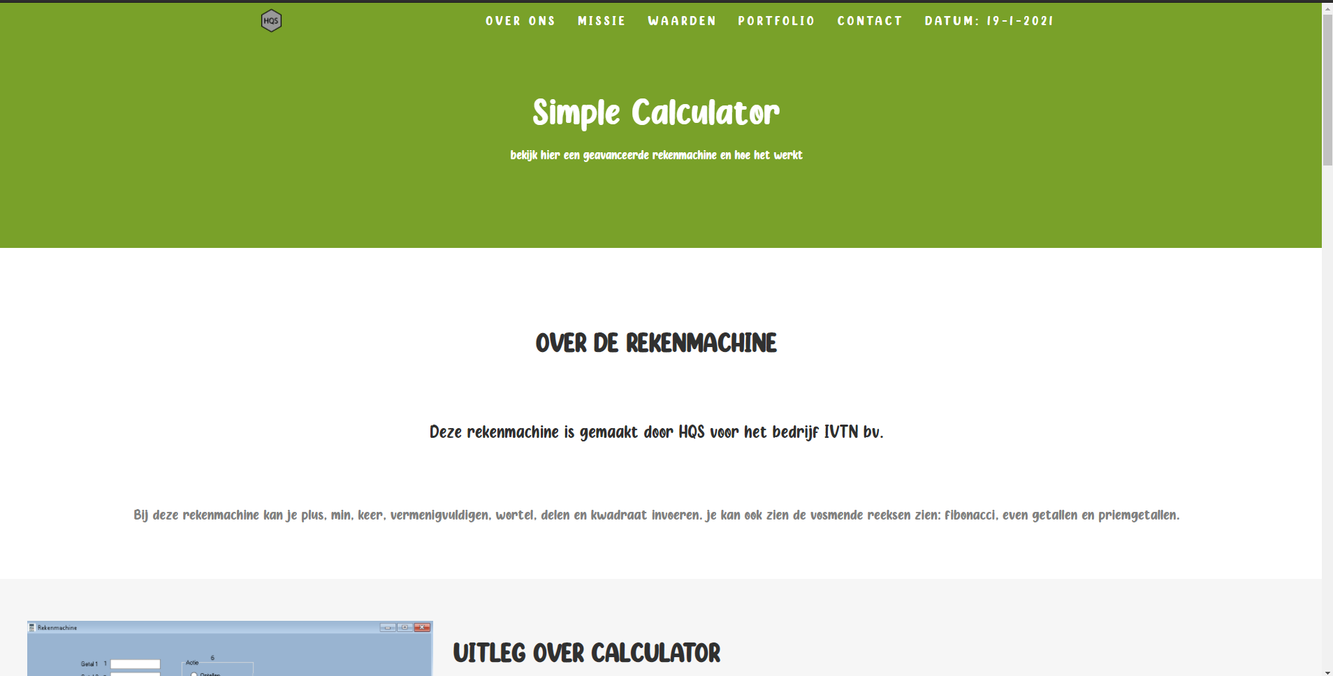
Simple Calculator

Slide 8
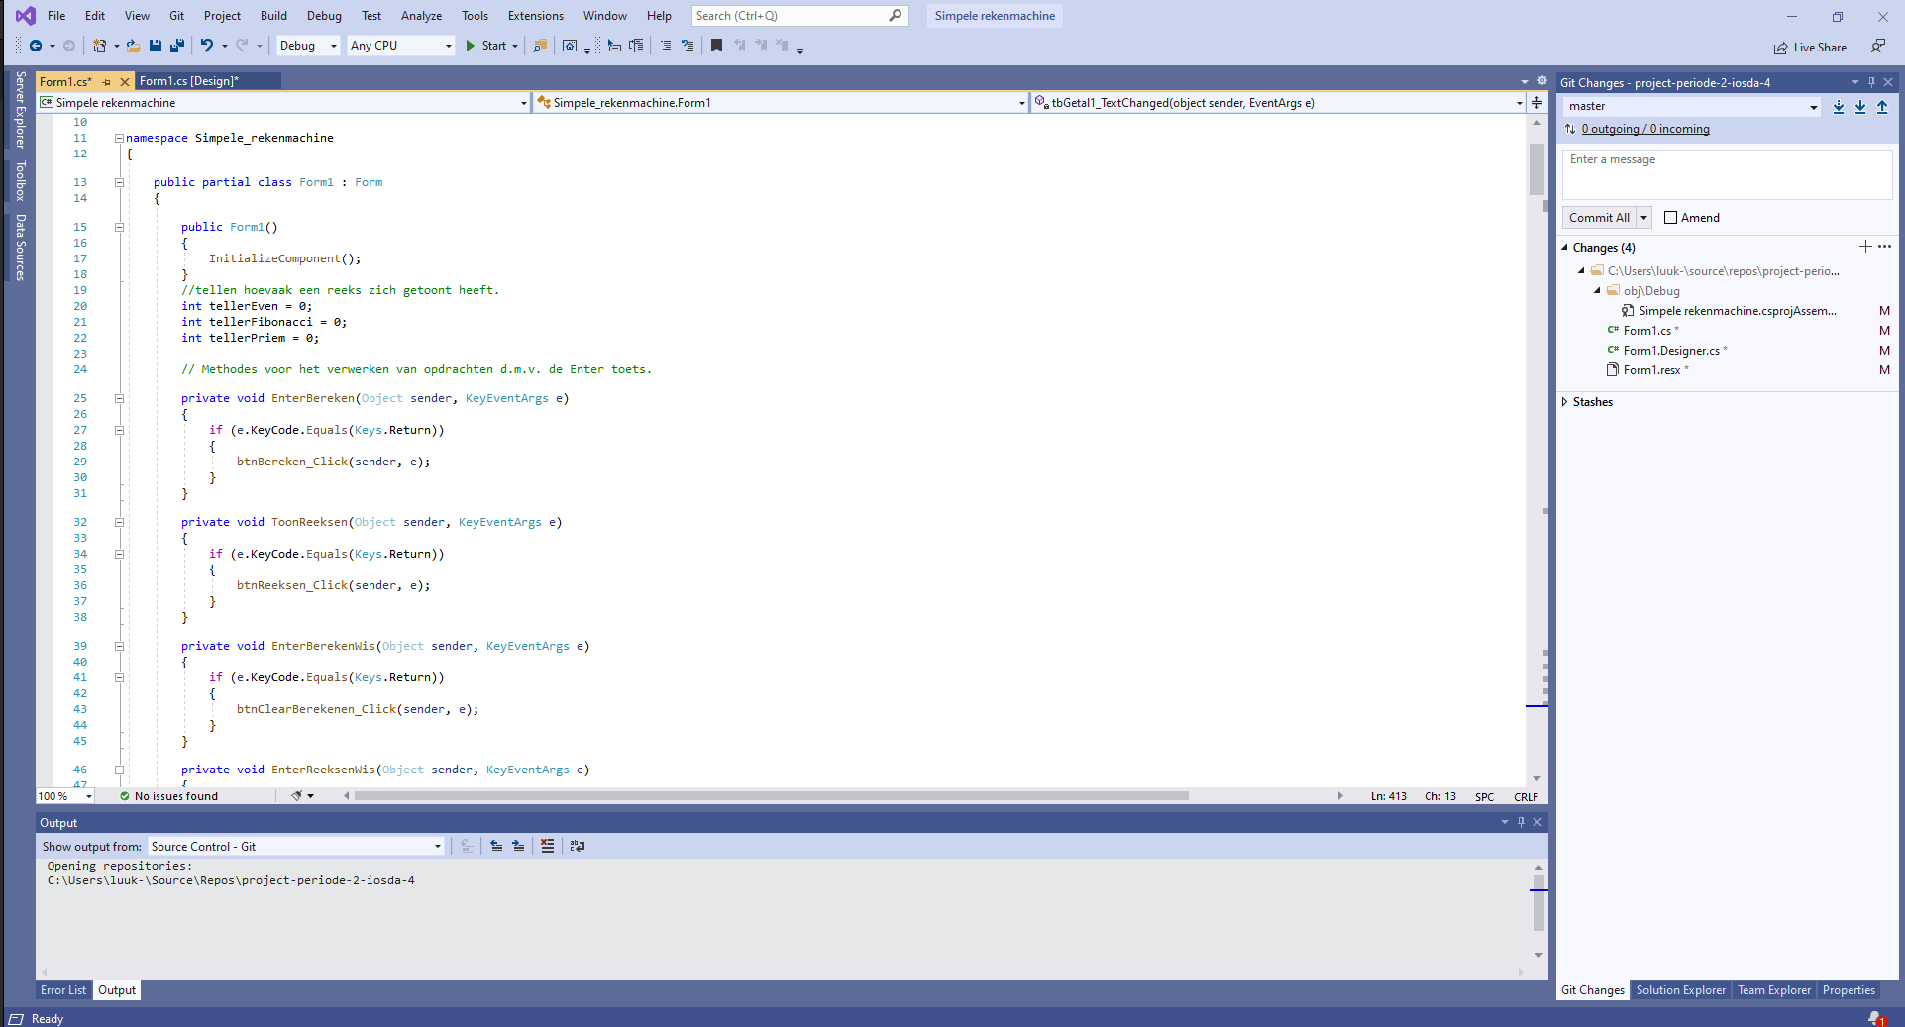
Simple Calculator Code

Slide 9
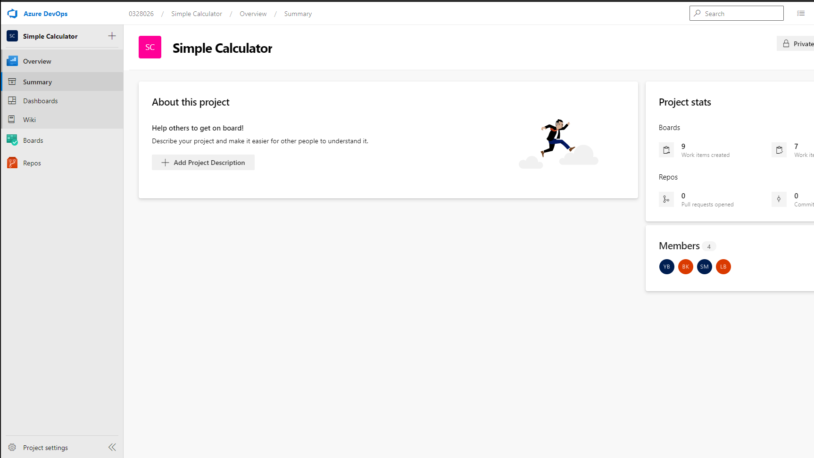
DevOps

Slide 10
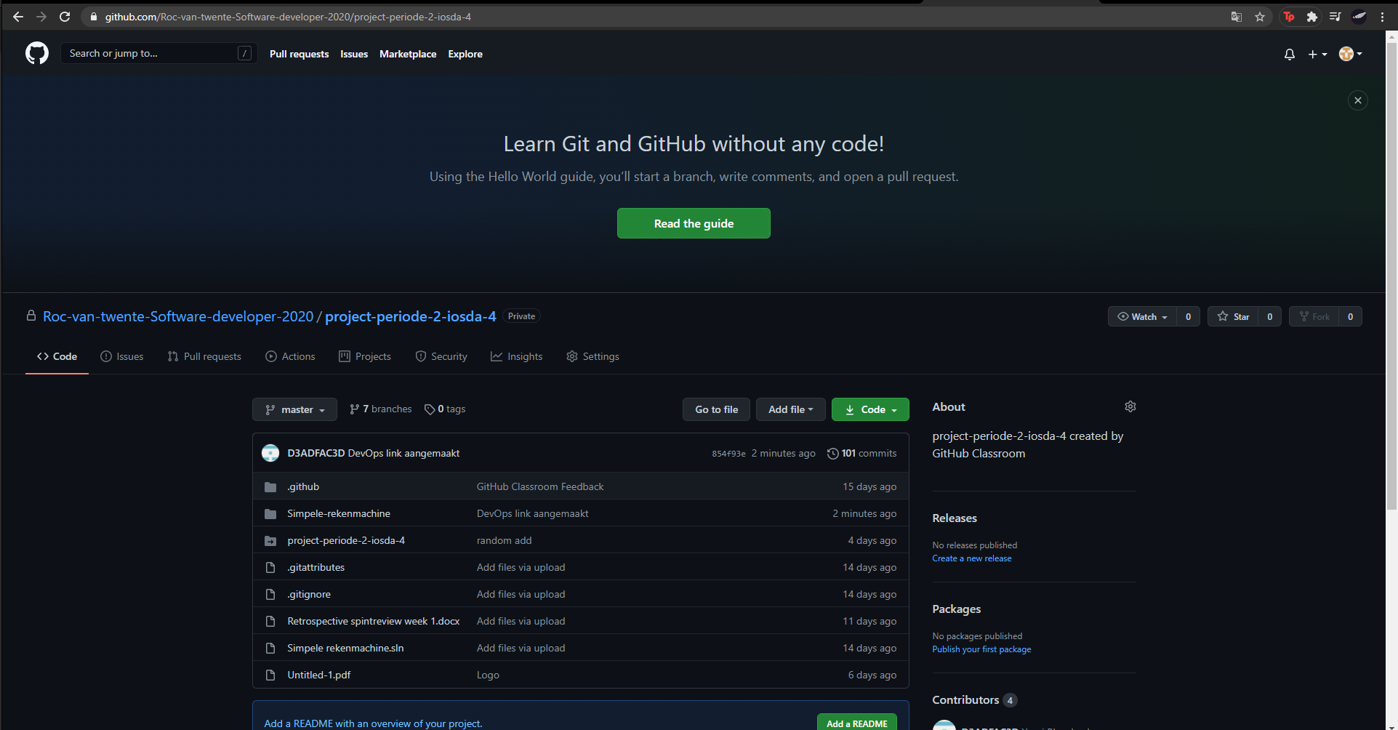
Github

Slide 11

Vragen

